Slide 1
CipherGate
A simple, yet effective door locking mechanism
Student:
Oltean Robert

Slide 2
01
Introduction
02
Components
03
Circuit Diagram
04
How it works
CONTENTS

Slide 3
Welcome to CipherGate, the Arduino-powered electromagnetic door lock system. Combining RFID, keypad and a LCD screen, it ensures secure and user-friendly access control.
01
Introduction
Our project

Slide 4
Explore the essential components powering CipherGate
02
Components
What our project is made of

Slide 5
Components
- Arduino Uno R4 WiFi board
- Single Channel 5V Relay Breakout Board
- JIS 842-901G electromagnetic door lock
- 4x3 Keypad
- MFRC522 RFID Reader
- 16x2 LCD Display
- I2C Controller for the 16x2 Display
- PNP transistor BC557CBK
- Diode 1N4148

Slide 6
Mapping the design
powering CipherGate
03
Circuit Diagram
All the components together

Slide 7
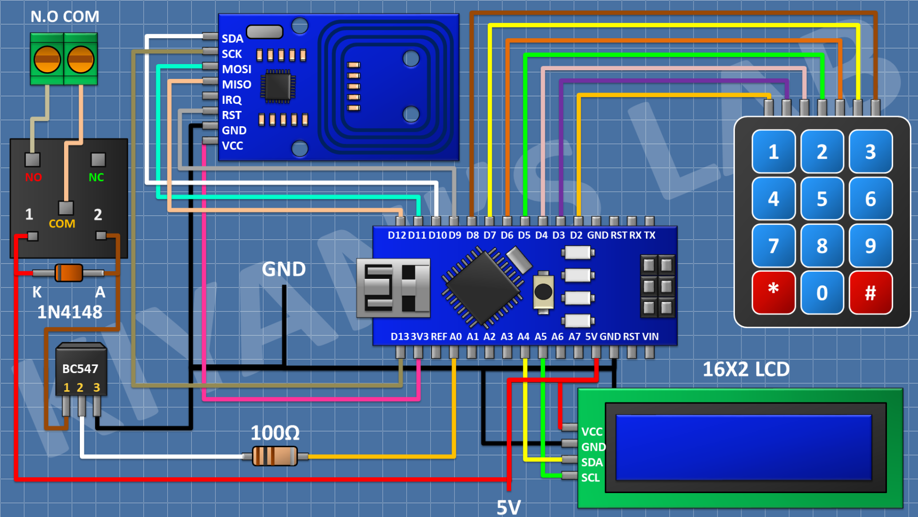
Circuit Diagram
See how the pieces fit together in CipherGate's circuit diagram – where the Arduino, RFID, keypad, LCD screen create our smart door lock system

Slide 8
User guide
04
How it works

Slide 9
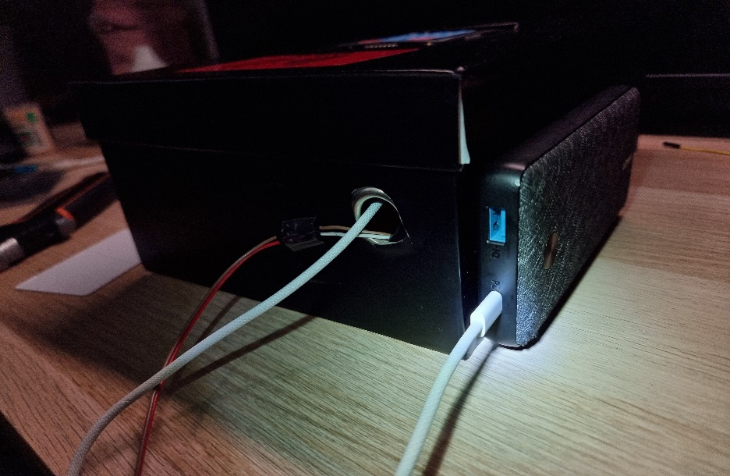
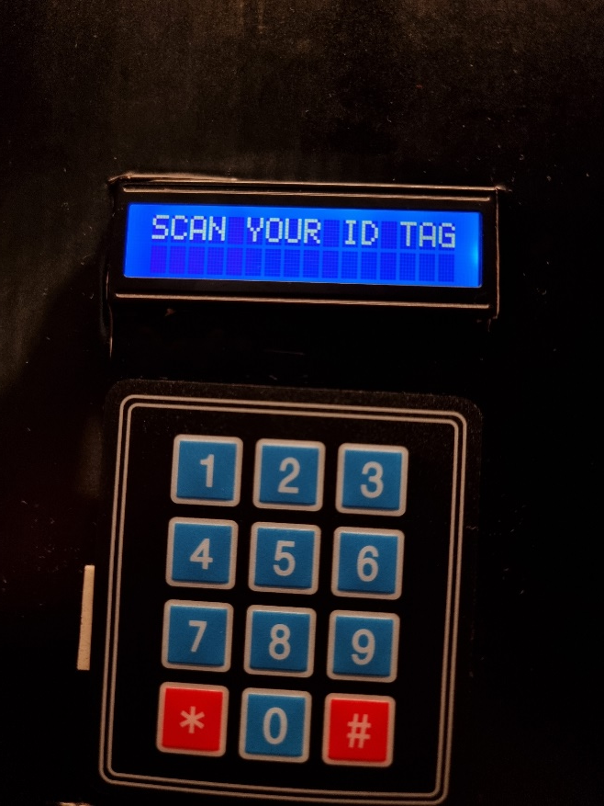
User guide
Step 1. Connect to the
power supply
Step 2. Wait for the screen to show this

Slide 10
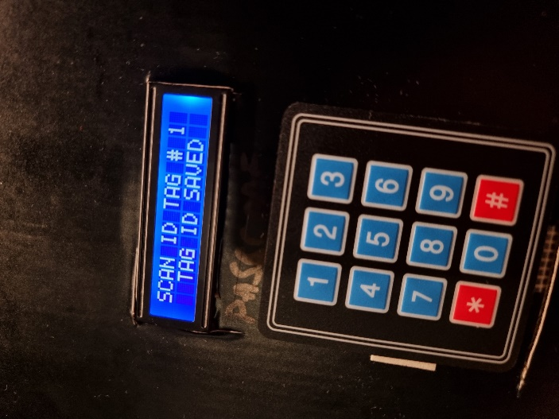
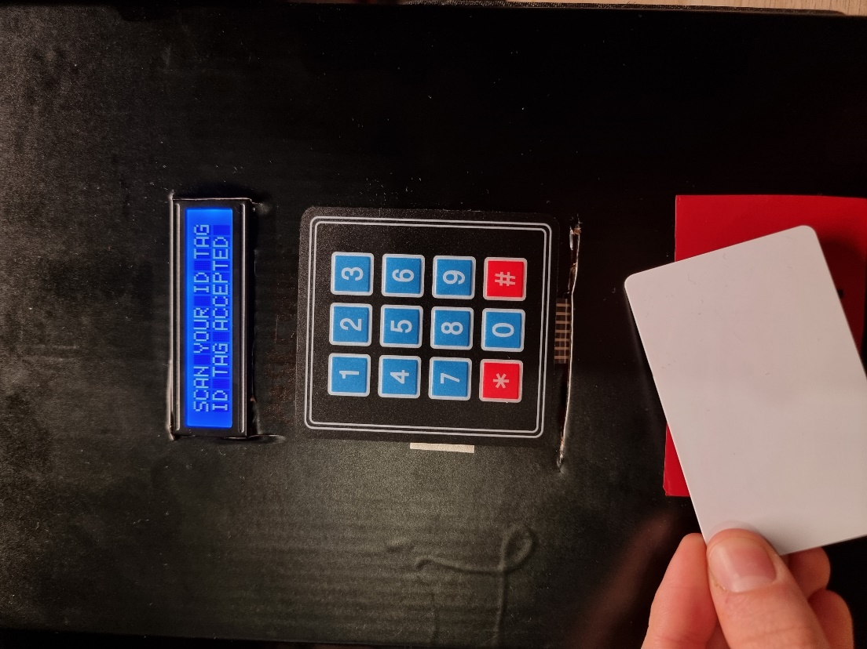
User guide
Step 3. To add a new tag to the device, enter *001 then your current PIN code on the keypad
Step 4. Approach your RFID Tag to the reader. Then your new tag is saved.
You can add up to 5 tags!

Slide 11
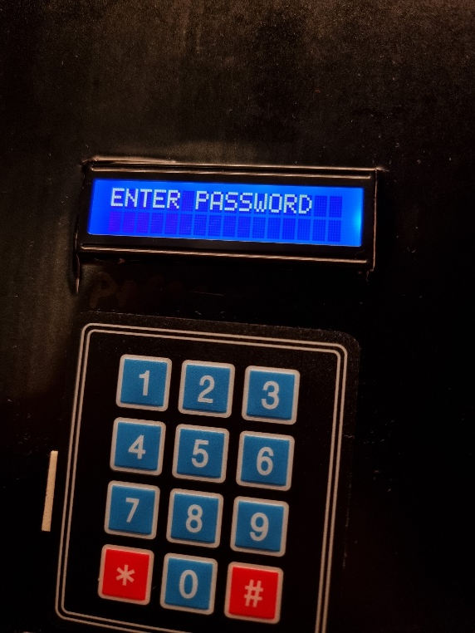
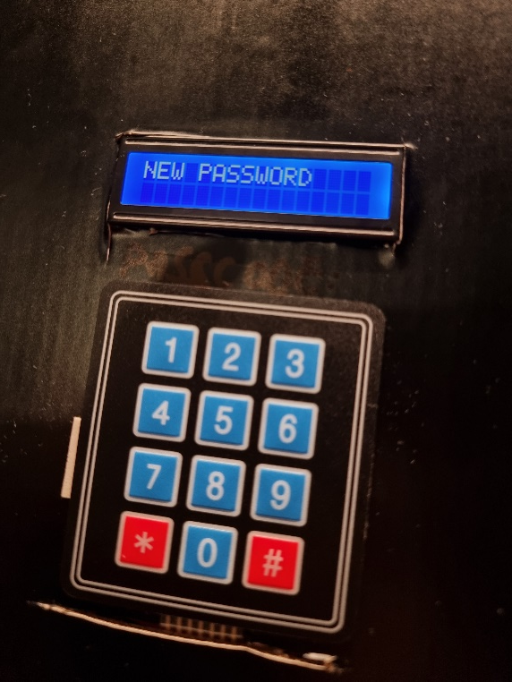
User guide
Step 5. To change your password,
type *000, then your current password.
Step 6. Now you can enter your new
password

Slide 12
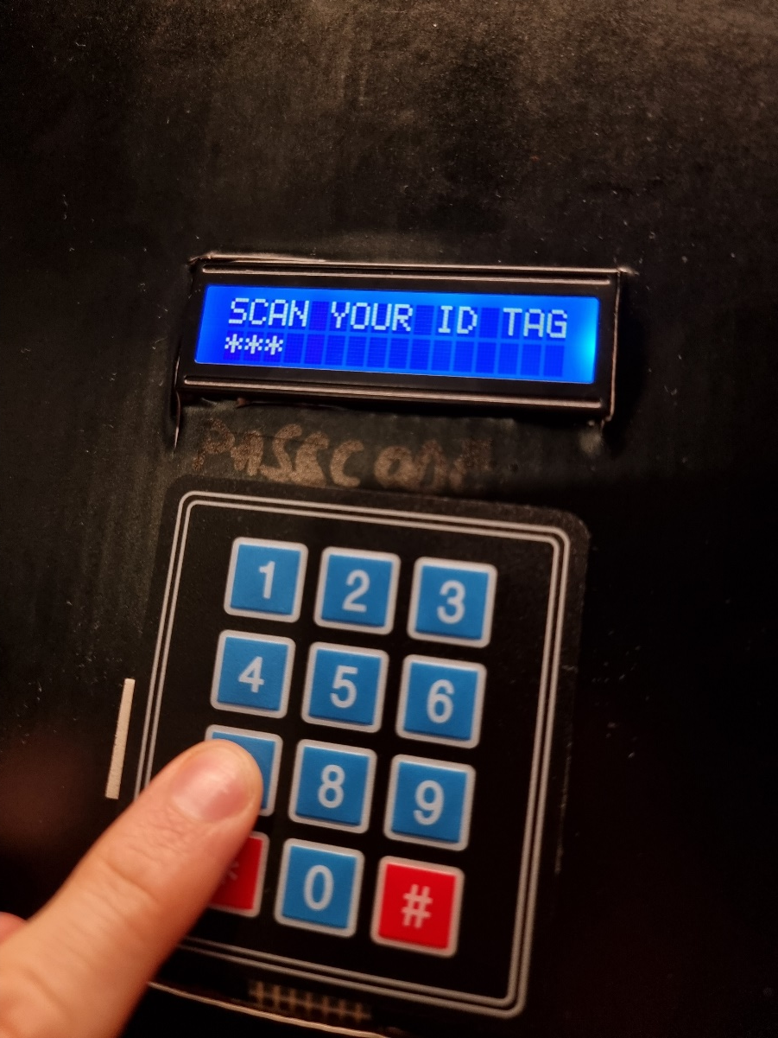
User guide
Step 7. Congrats! You have successfully set up your CipherGate device!

Slide 13
Thank you! ☺

